Slide 1

Beyond ‘Low Risk’
WAKE COUNTY EMS
1
Mental status & capacity
2
Conversation
3
Well-person check
A risk-factor approach to suicide assessment in the field
4
Decision
SRFA = Suicide Risk Factor Assessment
APP introduction · Simulation testing
Notes:
Hi everyone, and thanks for taking about fifteen minutes for this. You're about to help test something new: the Suicide Risk Factor Assessment, or S-R-F-A.
Here's where we're headed. First, why we're changing how we handle these calls. Then a tour of the app, with a closer look at the A-S-Q and at getting your documentation into the e-P-C-R. And last, your part: the simulation test. Let's get into it.

Slide 2
Mental health calls are routine. Our tools aren’t
1 in 9
0 of 15
59%
EMS calls attended are mental health or self-harm related
suicide risk instruments reviewed were accurate enough to rely on
of ambulance staff report insufficient mental health training
11% of attended calls · Scottish national record-linkage study
Runeson et al., PLOS ONE 2017 (systematic review)
de Lyra et al., 2025
Every one of these calls ends in a disposition decision, and a record that has to stand up afterward.
Notes:
Let's start with how often we see these calls. About one in nine EMS calls involves mental health or self-harm. That comes from a full year of Scottish national ambulance data, and it's probably an undercount.
Now look at the tools. A systematic review looked at fifteen suicide risk instruments, and not one was accurate enough to rely on. We couldn't find a single one validated for prehospital use. And in a 2025 survey, fifty-nine percent of ambulance staff said their mental health training wasn't enough.
So these calls are common and high-stakes, and every one of them ends in a disposition and a record that has to hold up afterward.

Slide 3
Fifty years of research: risk prediction doesn’t work
Study | What it found | What it means for us
Large et al., 2016 PLOS ONE | Results vary so widely between studies that pooling them is questionable, and predictive accuracy has not improved over decades. | A better scale won’t fix this.
Carter & Spittal, 2018 Crisis | Sensitivity ~56%; positive predictive value ~5.5%. | ~44% of eventual suicides are missed; ~94.5% of those labeled ‘high risk’ will not die by suicide.
Franklin et al., 2017 Psychological Bulletin | 365 studies across 50 years: risk factors offer only slight predictive power. | No single factor, or checklist total, predicts who will die.
Takeaway The problem isn’t our tool. It’s the idea of predicting risk at all.
Notes:
Here's the research behind the change. Large and colleagues pooled the studies on suicide risk assessment. The results are all over the map, and accuracy hasn't improved in decades.
Carter and Spittal put numbers on it: sensitivity of about fifty-six percent, and a positive predictive value of about five and a half percent. In plain terms, a low-moderate-high system misses close to half of the people who go on to die by suicide. And about ninety-five percent of the people it labels high risk never will.
Franklin's team reviewed three hundred sixty-five studies covering fifty years, and found that risk factors predict only slightly better than chance.
So the answer isn't a better scale. The problem is trying to predict at all.

Slide 4
Prediction fails. The factors still matter
We don’t use them to predict who will die. We use them to know what to ask and document.
WHERE THE NUMBERS COME FROM
One meta-analysis of 37 psychological autopsy studies: 5,633 suicide deaths and 7,101 controls across 23 countries (Favril 2022). One yardstick, so the bars compare directly.
HOW FACTORS MADE THE LIST
At least two independent peer-reviewed sources each (12 sources, 9 meta-analyses). Factors that held across study designs ranked higher.
HOW THEY’RE ORDERED IN THE APP
Field priority, not effect size: what a crew can see or ask on scene comes first.
Assessable on scene
History & context
† Anglemyer 2014 (16 studies). All other bars: Favril 2022.
Notes:
So if prediction doesn't work, why bother with risk factors? Because the links are real. They just can't tell you which person in front of you is going to die. That's why we use them as a guide to what to ask and document, and never as a score.
Every bar here is a pooled odds ratio for suicide death. All but one come from a single meta-analysis, Favril 2022. It covers thirty-seven studies, more than fifty-six hundred suicide deaths, and twenty-three countries. They all use one yardstick, so you can compare the bars directly. Firearm access comes from a separate review, Anglemyer 2014, and it's marked.
To make our list, a factor needed at least two independent, peer-reviewed sources. The blue bars are the things you can see or ask about on scene, so those come first in the app. That order is about what you can check in the field, not about effect size.
These factors are strong across populations but weak for any one patient. And that's exactly why the app has you document them and never add them up.

Slide 5
Assess risk factors. Don’t assign a risk level
 | Traditional risk assessment | SRFA: risk-factor assessment
Output | A score or a low / moderate / high label | Documented findings, each with its source and the patient’s own words
Purpose | Predict who will die | Inform the plan for this patient, tonight
Documentation | “Low risk, denies SI” | ASQ answers, observed factors, capacity, reasoning
Disposition | “Cleared” | Disqualifier check, then disposition with safety plan and follow-up
Evidence | Not accurate enough to be clinically useful | Safety plan + follow-up: suicidal behavior 5.29% → 3.03% (Stanley 2018)
Medicolegal | Rests on a label the research calls unreliable | Rests on findings and reasoning in the record
Notes:
That brings us to the heart of the change: assess risk factors, and don't assign a risk level.
The old way gives you a label, and a chart that says something like "low risk, denies S-I." S-R-F-A gives you findings instead: the A-S-Q answers, which risk factors are present or denied and who reported them, capacity, and your reasoning.
Instead of "cleared," the disposition runs through a disqualifier check. And when a patient stays home, they get the one intervention with outcome data behind it. In Stanley's 2018 study, a safety plan plus a follow-up call cut suicidal behavior from about five point three percent to three percent.
It's better care, and it's a stronger record.

Slide 6
What the program sets out to do
1
Standardize the assessment
One structured approach for every APP mental-health or suicide-related call.
DESIGN PRINCIPLE
Not a predictive instrument.
Not a clearance tool.
2
Document findings, not labels
Replace ‘low risk’ with findings that hold up against the evidence.
3
Make capacity its own finding
The five-part protocol standard, recorded line by line.
The app tracks what the APP finds. The APP makes the decision.
4
Structure non-transport
Safety plan, means counseling and a follow-up call with a named owner.
5
Route social needs
Housing, food, medication and justice needs flagged for referral.
Notes:
So what is this program trying to do? Five things.
First, one standard approach for every A-P-P mental health or suicide-related call. Second, findings instead of labels. Third, capacity as its own documented finding, because capacity is what makes a refusal valid. Fourth, real structure for non-transport: a safety plan, means counseling, and a follow-up call that somebody owns. And fifth, flagging social needs like housing, food, and medications for referral.
And one rule governs all of it: this is not a prediction tool, and it's not a clearance tool.

Slide 7
No patient identifiers.
Nothing stored. Nothing sent.
PATIENT PRIVACY
✕
Not collected
✕
Not transmitted
✕
Not kept
No fields for name, date of birth, address, phone, MRN or incident number.
No server, no database, no network calls. The app runs entirely in the browser.
The draft lives only in the open tab and is erased when it closes. The export goes into the ePCR, the secure record.
The one rule for providers: keep names and other identifiers out of the free-text boxes.
Notes:
A quick word on privacy, because it matters.
The app has no field for a name, date of birth, address, phone number, M-R-N, or incident number. Nothing gets sent anywhere: there's no database, and it runs entirely in your browser. And nothing is kept. Your draft lives in the open tab and is erased when you close it. The e-P-C-R is still the secure record.
That leaves just one rule for you: keep names and other identifiers out of the free-text boxes.

Slide 8
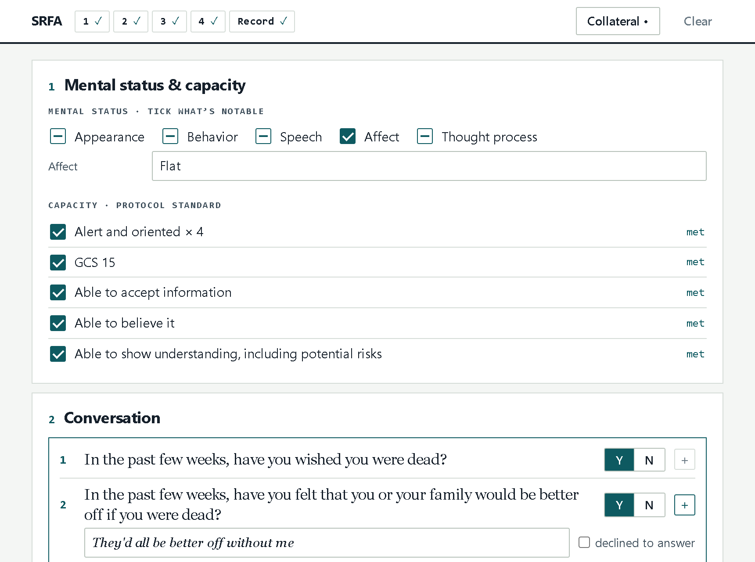
It tracks. It doesn’t decide
✓
One page
Four numbered sections plus Record, worked in any order.
✓
No scores or counts
No totals, no risk level, no automatic disposition.
✓
Collateral kept separate
Police and bystander accounts recorded apart from the patient’s, with means present or secured.
✓
Built for the field
Open-item counters per section; drafts erase when the tab closes.
Notes:
Here's the app. It's one page, with four numbered sections plus a Record section. The counters across the top show what's still open in each section.
And the title says it all: it tracks, it doesn't decide. There are no scores, no totals, and no automatic disposition. The clinical judgment stays with you.

Slide 9
Working a call
Arrive & collateral
Rapport
1
Mental status & capacity
2
Conversation
3
Well-person check
Police, family, bystanders; means on scene
Listen, reflect, slow the scene down
Five-part standard
ASQ verbatim, risk factors, social needs
Vitals, glucose, breath test
Transport
4
Decision
Record
ED or alternate destination
Disqualifiers, disposition, patient’s response
Emergency commitment
Narrative + export, pasted into the ePCR
Handled by PD: custody
Home with safety plan
Follow-up call
Who stays, means counseling
APP call scheduled
Order is flexible. Work the sections in any order the situation and rapport allow. The app tracks what’s open, not the sequence.
Notes:
Here's how a typical call flows. You arrive and get collateral from police, family, or bystanders, and you build rapport. Then come the four sections: mental status and capacity, the conversation, the well-person check, and the decision. From there it's transport, emergency commitment, or home with a safety plan, and every path ends in the Record section.
And the order is flexible. If the patient opens up early, take the conversation when it comes. The app keeps track of what's still open, not the order you did it in.

Slide 10
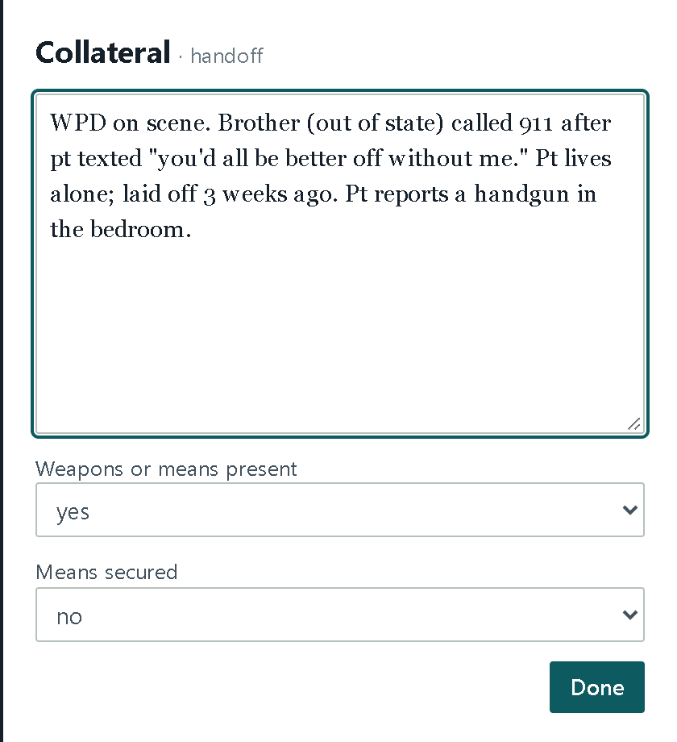
Collateral: what bystanders and police tell you
C
Open it from the top bar, from any section
CAPTURES
What PD, family or bystanders report: who called, what was said or done, who is staying. Plus weapons or means present, and whether they’re secured.
IN THE EXPORT
== HANDOFF [collateral — recorded separately from the patient’s account] ==
WPD on scene. Brother (out of state) called 911 after pt texted …
Weapons or means present: yes; secured: no
WHY IT MATTERS
Kept apart from the patient’s own account, so the record shows who said what.
A ‘yes’ on means also marks Access to lethal means present in §2, tagged C.
GUARDRAIL
Collateral is context, not the patient’s answer. Still ask the patient, and keep names out of the notes.
Notes:
Most of these calls start with someone else's story, and that goes in Collateral. It's the button at the top, and you can open it from any section. It records who called, what was said, who's staying, and whether weapons or other means are present and secured.
Collateral stays separate from the patient's account, so the record shows who said what. If collateral says means are present, the app also marks access to lethal means in the risk factors, tagged C.
But collateral is context. You still ask the patient.

Slide 11
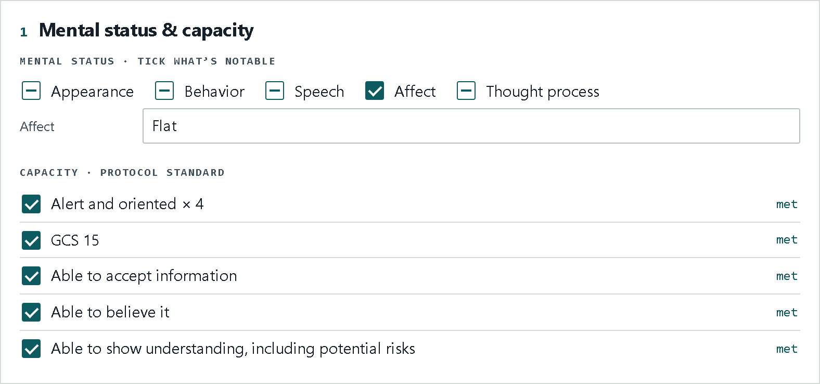
Mental status & capacity
1
CAPTURES
Mental status built on the ABSATTC extended MSE (tick only what’s notable), plus the five-part capacity standard.
WHY IT MATTERS
Capacity becomes its own documented finding, the foundation of any refusal.
Built on the ABSATTC extended mental status exam (Carlat)
GUARDRAIL
Any ‘not met’ requires a note naming exactly what failed.
A
B
S
A
T
T
C
Appearance
Behavior
Speech
Affect
Thought process
Thought content
Cognition
§1
§1
§1
§1
§1
§2 chips
§1 capacity
Notes:
Section one is mental status and capacity. The mental status piece is built on the A-B-S-A-T-T-C extended mental status exam. Tick only what's notable.
Then work the five-part capacity standard from protocol, one line for each point. If any point isn't met, the app asks you to note what failed, so "lacks capacity" never stands on its own.

Slide 12
What is the ASQ?
The Ask Suicide-Screening Questions: a brief screen developed by the National Institute of Mental Health (NIMH).
4 + 1
questions: four screening questions, plus an acuity question asked only after a yes
HOW A SCREEN IS READ (NIMH TOOLKIT)
No to questions 1–4
Negative screen
~20 sec
Yes to any of 1–4, or declined
Positive screen: ask question 5
to administer, word for word
Yes to question 5
Acute positive: AD or ED transport
Validated
in youth (pediatric EDs, 2012) and adults (medical inpatients, 2020: sensitivity 100%, specificity 89%)
A screen, not a prediction. A positive screen opens the risk-factor conversation; it doesn’t end it. Not yet validated for prehospital use.
Notes:
Section two opens with the A-S-Q, so let's slow down here, because this one matters.
The Ask Suicide-Screening Questions come from the National Institute of Mental Health. There are four screening questions, plus a fifth that you ask only after a yes. The whole thing takes about twenty seconds.
It's been validated in kids in pediatric E-Ds, and in adult medical inpatients. In the adult study it caught every patient at risk, with eighty-nine percent specificity.
One honest caveat: it hasn't been validated in the field yet. Part of what this simulation test does is see how it works for us.

Slide 13
The questions, word for word
Read them exactly as written, every time. Rewording voids the validation.
1
In the past few weeks, have you wished you were dead?
2
In the past few weeks, have you felt that you or your family would be better off if you were dead?
3
In the past week, have you been having thoughts about killing yourself?
4
Have you ever tried to kill yourself?
ONLY AFTER A YES TO ANY OF 1–4 · ACUITY
5
Are you having thoughts of killing yourself right now?
Notes:
Here are the questions, exactly as they appear in the app.
"In the past few weeks, have you wished you were dead?" "In the past few weeks, have you felt that you or your family would be better off if you were dead?" "In the past week, have you been having thoughts about killing yourself?" And, "Have you ever tried to kill yourself?"
If the answer to any of those is yes, you ask the fifth: "Are you having thoughts of killing yourself right now?"
Ask them word for word. It can feel blunt, and that's on purpose. Direct questions don't plant the idea, and they tell the patient it's okay to answer honestly. And if you reword them, the validation no longer applies. Read them as written, every time.

Slide 14
Reading the screen
How the NIMH toolkit reads the ASQ.
SCREEN
WHEN
WHAT IT MEANS
Negative
No to questions 1–4
Keep going with the risk factors. It isn’t clearance.
Positive
Yes to any of 1–4, or declined to answer
Ask question 5, then work the risk-factor conversation.
Acute positive
Yes to question 5
Transport: alternate destination or ED. Police for emergency custody if needed.
A screen, not a prediction. A positive screen isn’t a risk level and a negative screen isn’t clearance. The decision comes from everything you find.
Notes:
Here's how the screen is read under the N-I-M-H toolkit.
No to all four is a negative screen. A yes to any of the four is a positive screen, and that's when you ask question five. If the patient declines to answer any of them, treat it as a positive screen too.
A yes to question five, thoughts of killing yourself right now, is an acute positive. That means transport, either to an alternate destination or to the E-D. And if it's needed, police get involved for emergency custody.
Here's what it doesn't mean. A positive screen isn't a risk level, and a negative screen isn't clearance. A positive screen tells you to keep going into the risk factors. The decision still comes from everything you find.

Slide 15
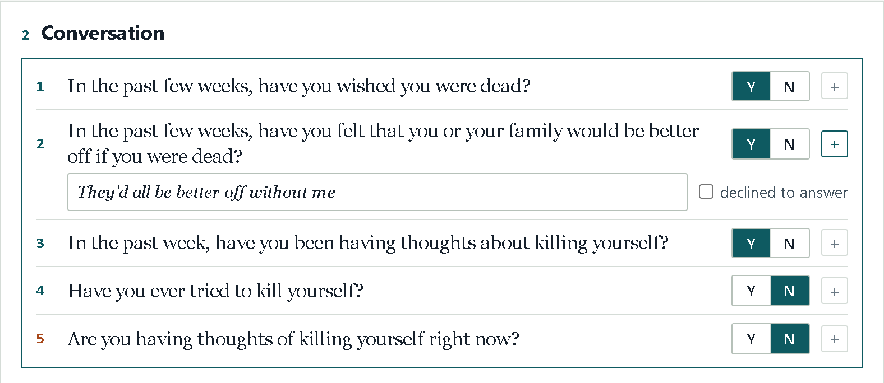
Conversation: recording the ASQ
2
CAPTURES
Y or N for each question. + opens the patient’s own words and “declined to answer.” A yes on Q4 adds when and how many times. Q5 appears after any yes.
WHY IT MATTERS
Declined counts as a positive screen. The export lists every answer and quote, administered verbatim.
GUARDRAIL
Asked word for word. Rewording voids the validation.
Notes:
In the app, each question gets a yes or no tap. The plus button opens a box for the patient's own words. Use it. "I thought about taking all my pills" says a lot more than a check mark.
If the patient won't answer, tick "declined to answer." Remember, that counts as a positive screen. If question four is yes, two more fields appear: when it happened, and how many times. And as soon as any answer is yes, question five shows up on its own.
In the export, the A-S-Q is listed as administered verbatim, with each answer and quote, so anyone reading your chart sees exactly what was asked and what the patient said.

Slide 16
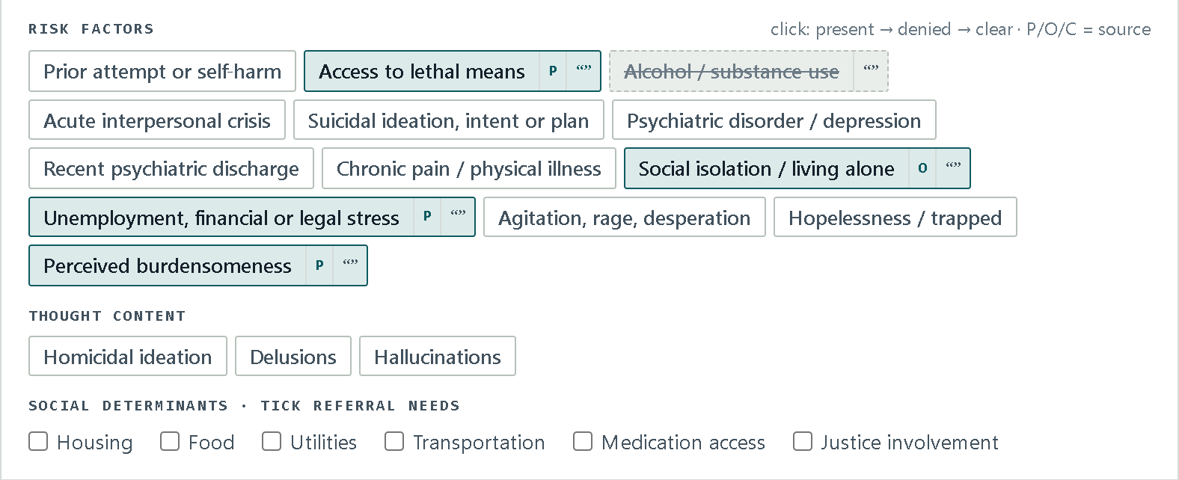
Conversation: risk factors & social needs
2
CAPTURES
13 risk factors marked present or denied, each tagged P (patient), O (observed) or C (collateral), with an optional quote. Thought content, and social needs for referral.
WHY IT MATTERS
Each finding shows who reported it and in whose words.
GUARDRAIL
Factors are never totaled. No count, no score.
Notes:
The rest of the conversation is the risk factors. That's the ten from the chart you saw earlier, plus three near-term warning signs: agitation, hopelessness, and feeling like a burden.
Tap once for present and again for denied. Each finding gets a source: P for patient, O for observed, or C for collateral. You can add a quote too. Social needs for referral sit right underneath.
And again, the app never adds them up.

Slide 17
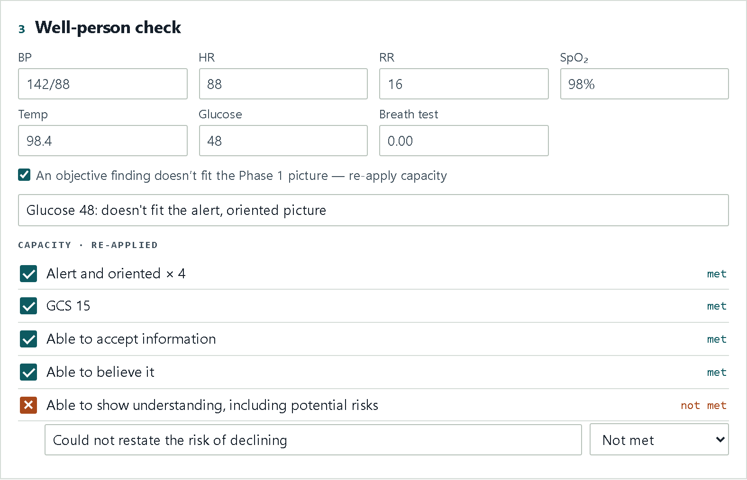
Well-person check
3
CAPTURES
BP, HR, RR, SpO₂, temp, glucose, and a breath test if indicated.
WHY IT MATTERS
Rules out a medical cause hiding behind a behavioral presentation.
GUARDRAIL
A finding that doesn’t fit triggers a capacity re-check on the spot.
Illustration: a glucose of 48 doesn’t fit the earlier picture, so capacity is re-applied.
Notes:
Section three is the well-person check: blood pressure, heart rate, respirations, S-p-O-2, temperature, glucose, and a breath test when it's indicated.
If something doesn't fit the earlier picture, like this glucose of forty-eight, tick the box and run the capacity standard again right there.

Slide 18
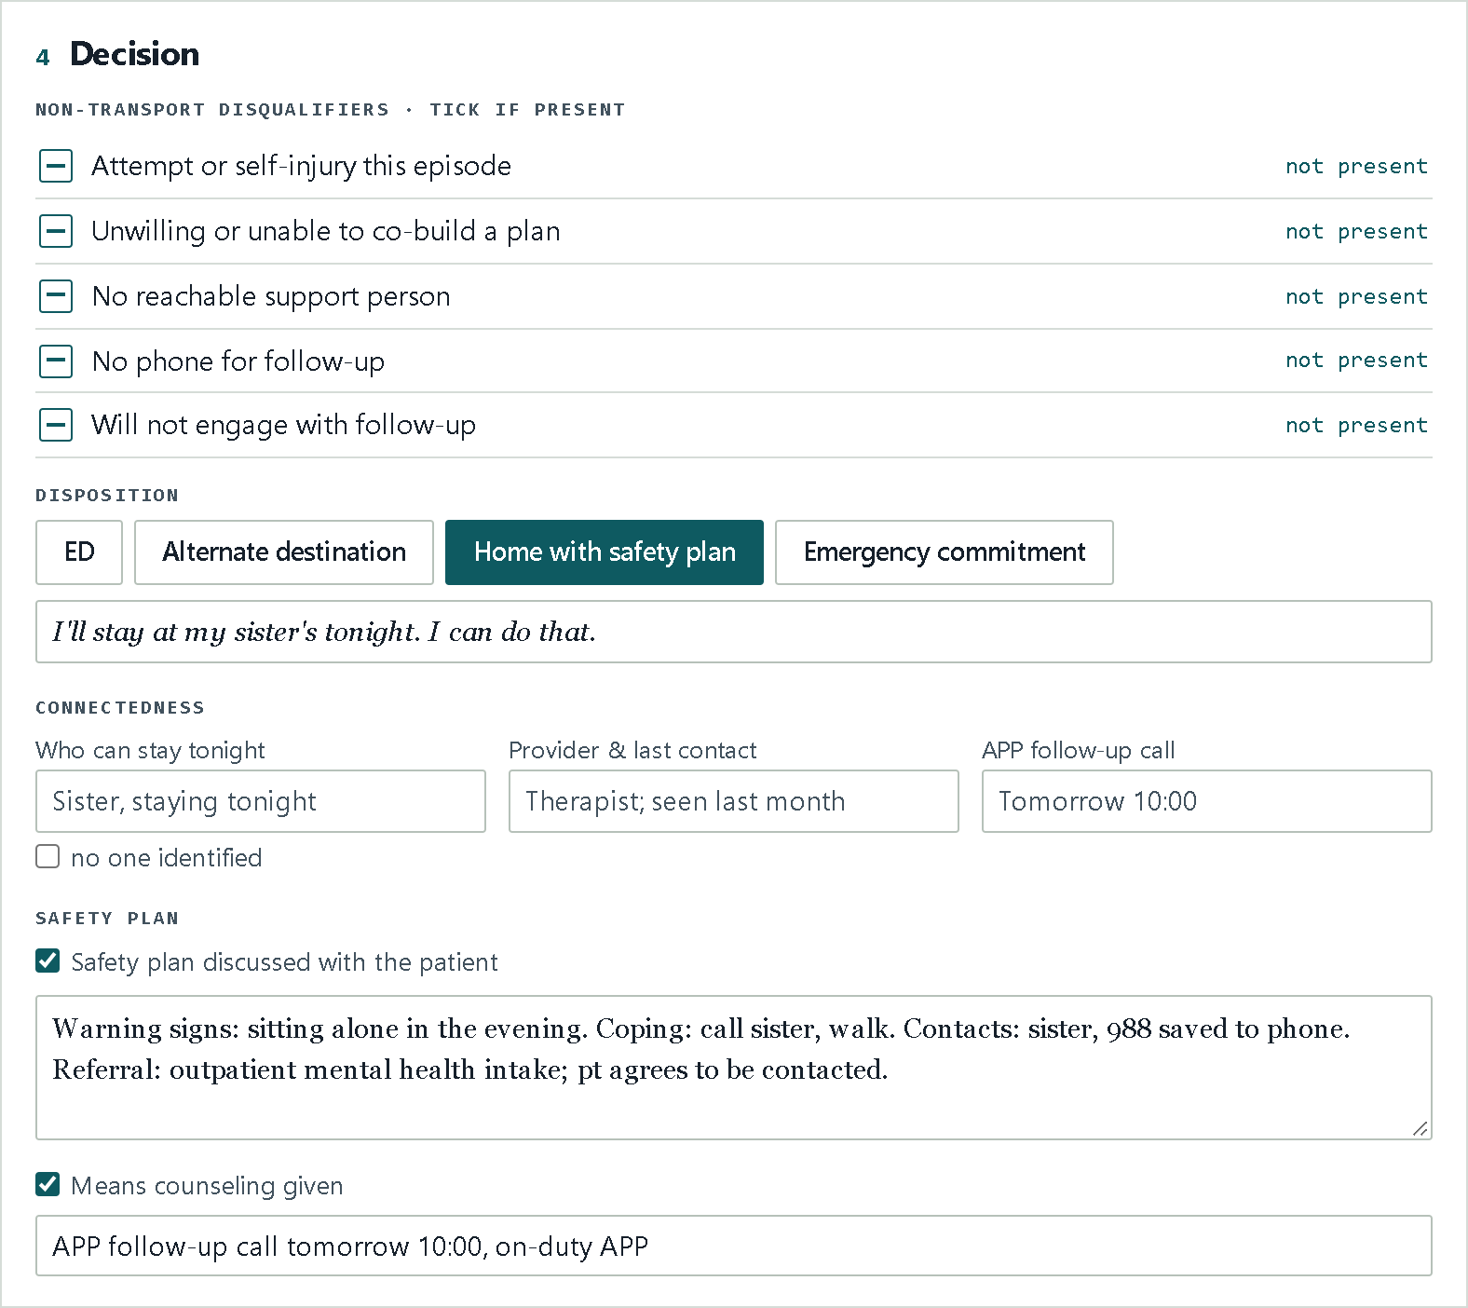
Decision
4
CAPTURES
Five non-transport disqualifiers, the disposition, and the patient’s own words. Home: who stays, follow-up, safety plan, means. Emergency commitment: PD officer and agency.
WHY IT MATTERS
Non-transport becomes an intervention with an owner, not just a refusal.
GUARDRAIL
No disqualifiers present is not a finding of low risk.
Notes:
Section four is the decision. Check the five non-transport disqualifiers. Then choose the disposition: the E-D, an alternate destination, home with a safety plan, or emergency commitment, which P-D handles. And record the patient's response in their own words.
One thing to remember: no disqualifiers doesn't mean low risk. It just means nothing rules out home.

Slide 19
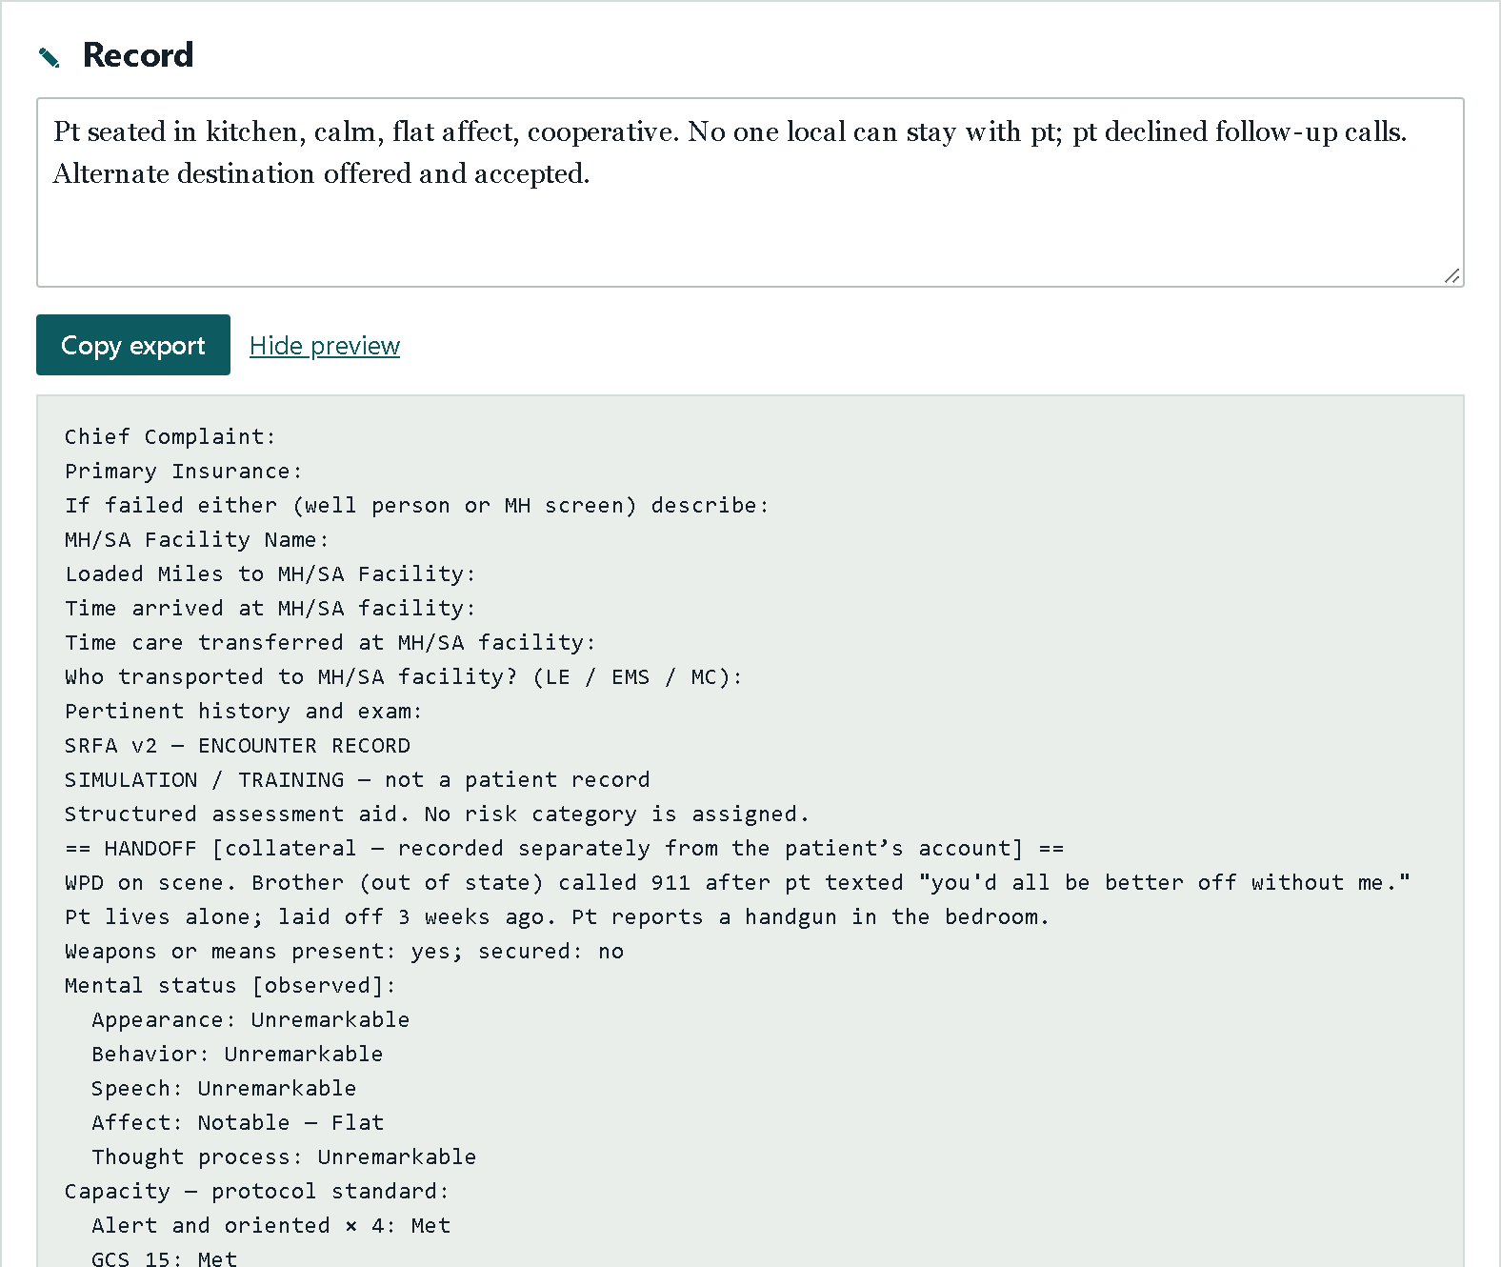
Record: one click from scene to ePCR
✎
CAPTURES
Provider narrative, then a structured export headed by the agency documentation template, verbatim.
WHY IT MATTERS
Only marked findings export. Nothing is implied by what’s left out.
GUARDRAIL
Flags phrases to reconsider: ‘low risk’, ‘not suicidal’, no-harm contracts, scores.
Notes:
Last comes the Record section, and this is where your documentation comes together.
The export always starts with our agency documentation template, exactly as written. After that come only the findings you actually marked, positive or negative. Nothing is implied by what's left out. Your narrative goes at the end.
The app also flags phrases worth a second look, like "low risk," "not suicidal," or a no-harm contract. It's a nudge, not a block.

Slide 20
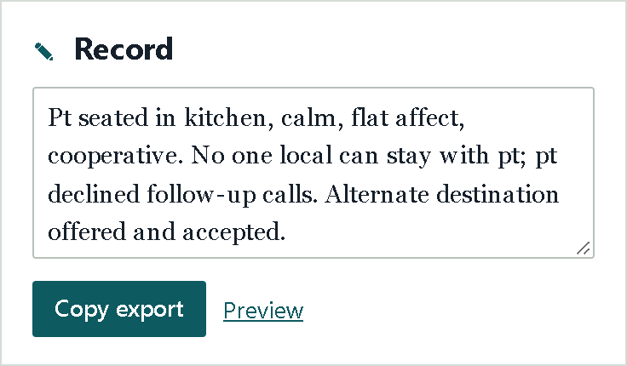
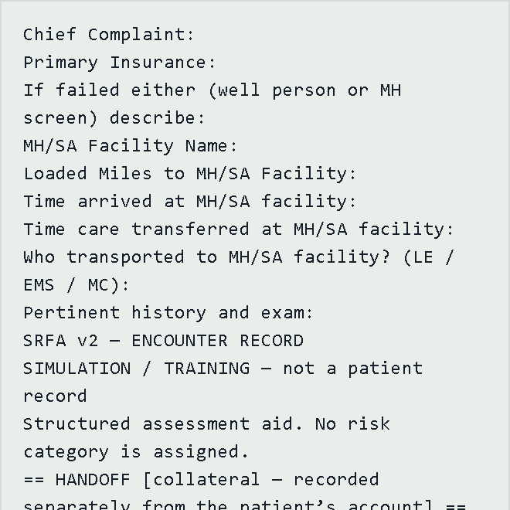
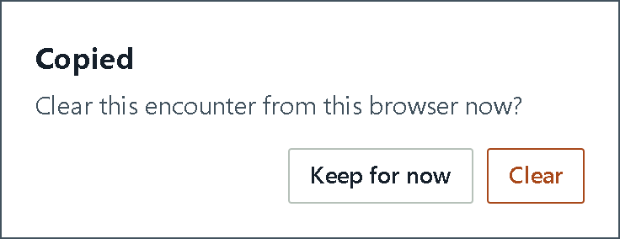
Preview, copy, paste
1
2
3
4
Write your narrative
Preview
Copy export
Paste, check, clear
In the Record section, at the bottom of the app.
See exactly what will paste: template, findings, then your narrative.
You’ll see “Copied.” Choose Keep for now until you’ve pasted.
Paste it, check it all came across, then come back and Clear.
For now
a Word document
At launch
the ePCR
Copy blocked? The preview opens on its own. Highlight the text, press Ctrl+C, and paste as usual.
Notes:
Here's how to get it out of the app in four steps.
One: write your narrative in the Record section.
Two: click Preview. That shows you exactly what will paste: the template, your findings, and your narrative. If something's off, fix it in its section and the preview updates as you go.
Three: click Copy export. You'll see a "Copied" message, and the app asks if you want to clear the encounter. Choose "Keep for now" until you've pasted.
Four: paste it. For now, just paste it into a Word document so you can see how it reads. Once we go live, this same paste goes into the e-P-C-R. Check that it all came across, then come back and clear.
And if your browser ever blocks the copy, no problem. The preview opens on its own. Just highlight the text, press Control-C, and paste as usual.

Slide 21
A worked call · The call
THE ASSESSMENT
THE CALL
Mental status & capacity Flat affect, otherwise unremarkable. All five capacity points met; sober.
1730 · A brother calls 911 from out of state.
A 54-year-old who lives alone and was laid off 3 weeks ago texted “you’d all be better off without me.”
Police on scene. The patient reports a handgun in the bedroom.
1
Conversation ASQ yes to 1–3 (“They’d all be better off without me”); no to 4 and 5. Unemployment, burdensomeness and a handgun present; lives alone.
2
Well-person check BP 142/88, HR 88, SpO₂ 98%, glucose 112, breath test 0.00.
3
Decision No one local can stay. Declines follow-up: “I’m not answering anyone’s calls.”
4
Notes:
Let's put it together with one call. It's five-thirty in the evening, and a brother calls 9-1-1 from out of state. His fifty-four-year-old sibling lives alone, was laid off three weeks ago, and just texted, "You'd all be better off without me." Police are on scene, and the patient tells you there's a handgun in the bedroom.
The patient is sober, meets all five capacity points, and has normal vitals. The A-S-Q is positive on questions one through three and negative on question five. But no one local can stay, and the patient says, "I'm not answering anyone's calls."

Slide 22
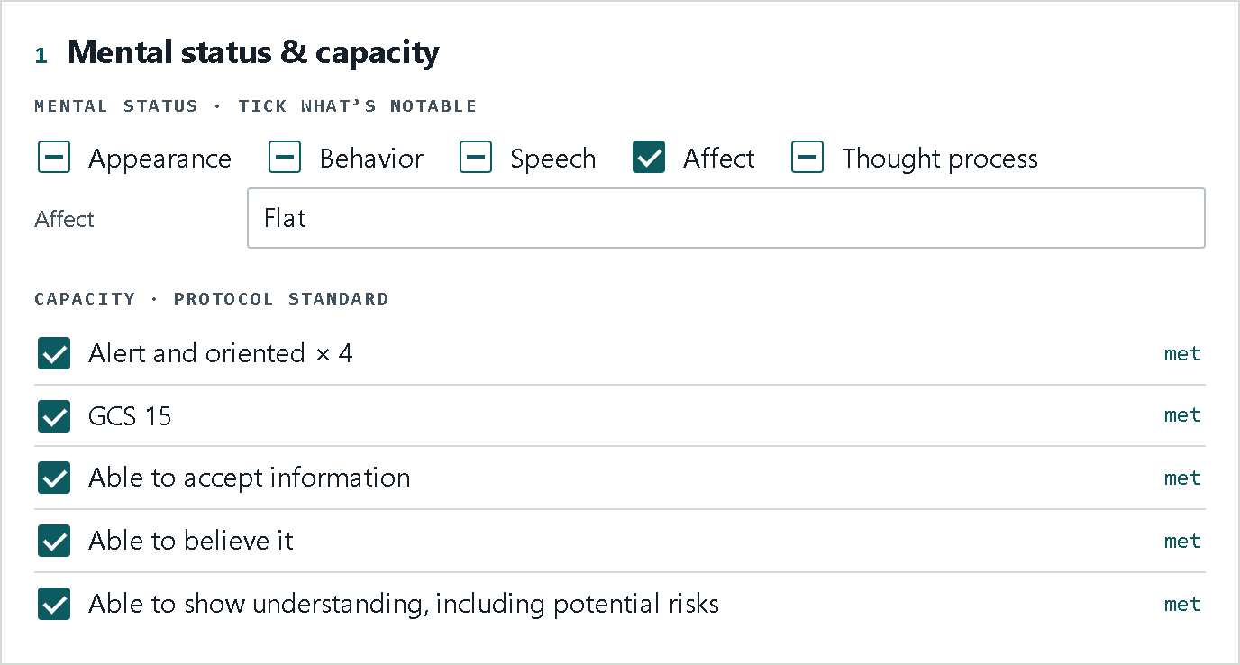
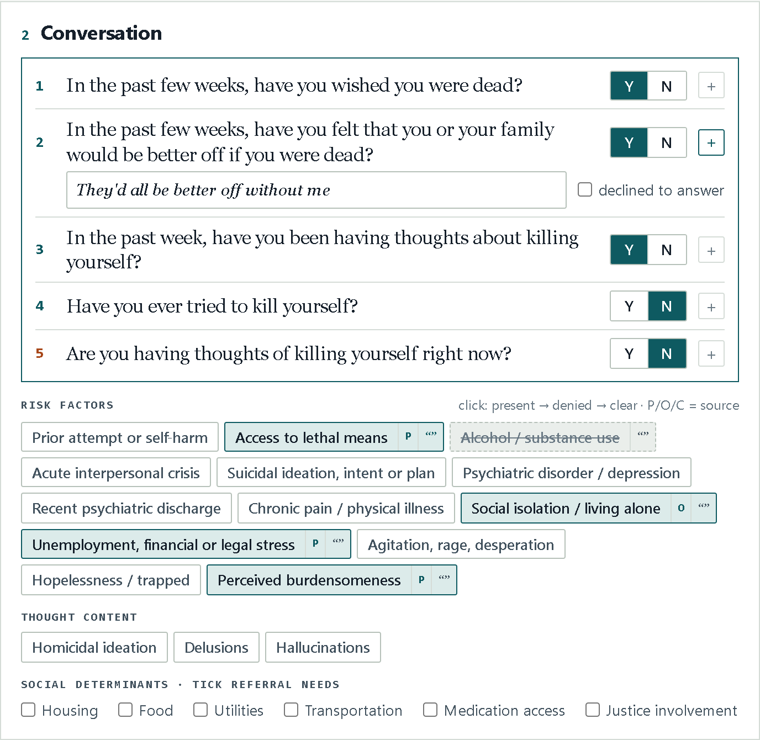
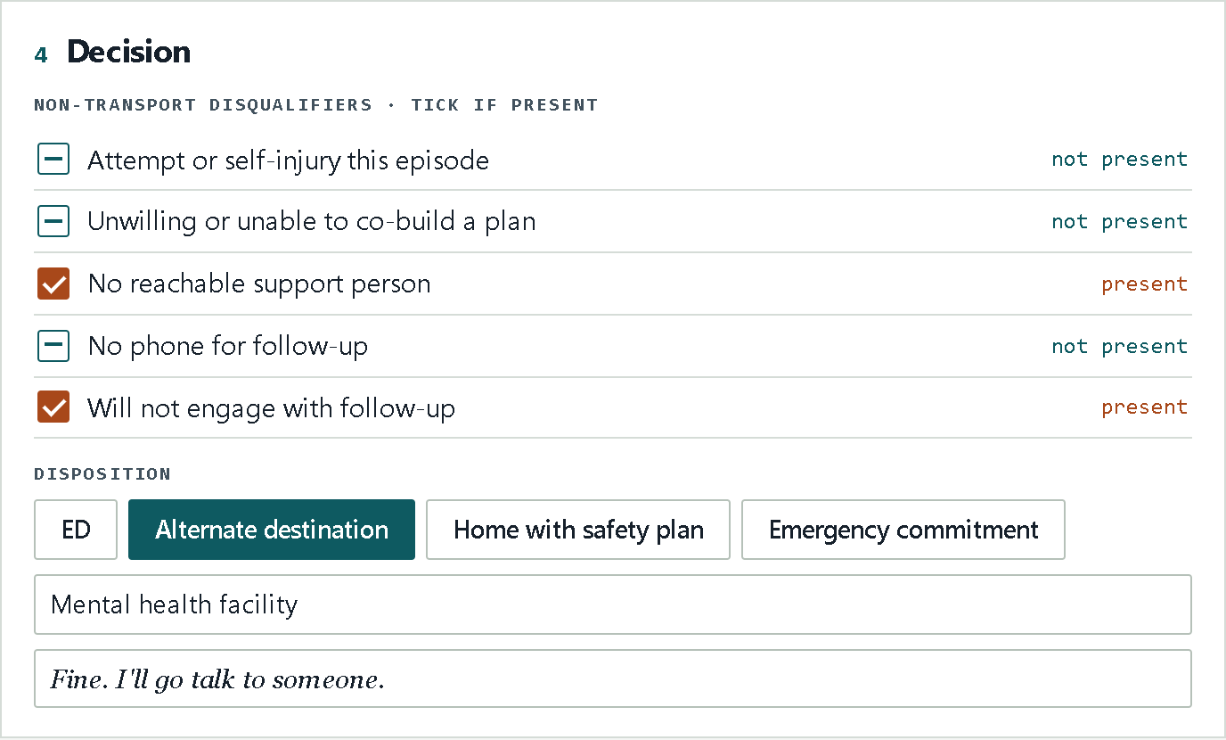
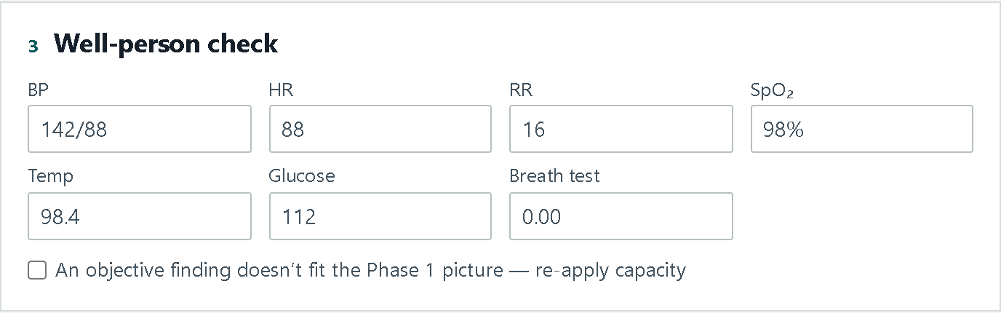
A worked call · The completed tool
DECISION
Sober with intact capacity doesn’t mean home. The record shows why.
Alternate destination. Mental health facility offered; patient agrees: “Fine. I’ll go talk to someone.”
Notes:
Here's that call in the app. Sections one through three look reassuring. Section four is where it turns: two disqualifiers are present, no reachable support person and won't engage with follow-up. Without those, there's no safe plan for home, so the A-P-P offers a mental health facility, and the patient agrees. "Fine. I'll go talk to someone."
The app didn't make that call. It structured it, and the record shows why.

Slide 23
Your part: the simulation test
1
2
3
It tests the tool, not you
Your results build v2
Anonymous, QI only
You’re helping find what the tool misses. Nobody is being graded.
Missed items, confusing wording and split decisions go straight into SRFA v2 before field use.
No names anywhere. Your results are used only for quality improvement.
Notes:
So here's where you come in. This is the second test cycle in our rollout, and it's a test of the tool, not a test of you.
You'll work through simulated calls using version one of the app. What we learn, like which items get missed, which wording trips people up, and where the decisions split, goes straight into version two before it goes to the field.
It's anonymous, and it's used only for quality improvement.

Slide 24
How it works
Make your code
10 cases
Use a laptop
Stop and come back
An anonymous code you build at the start. No names. Write it down.
A patient on video beside the app, in random order.
Phones are blocked. Any laptop with internet works.
Your work saves as you go, even in the middle of a case.
Submit once
Debrief at the end
Weekly survey
30-day window
A case locks when you submit. No redos, so work it like a real call.
No feedback along the way. We debrief together after all 10.
A short check-in each week while the test runs. Details coming.
The dates and the link come in your email.
Notes:
Here's how it works. When you start, you'll make your own anonymous code. No names, so write your code down. You'll get ten cases in random order, each one a patient on video beside the app. Use a laptop for this, because phones are blocked.
You don't have to finish in one sitting. Your work saves as you go, so you can stop and pick back up. When you submit a case, it locks, so there are no redos. Take your time and work it like a real call.
You won't get feedback along the way. We'll debrief together after everyone finishes all ten.
There's also a short weekly survey while the test is running, to hear how it's going for you. And you'll have a thirty-day window. The dates and the link will be in your email.

Slide 25
Questions?
Thank you.
REFERENCES
Epidemiology of emergency ambulance service calls related to mental health problems and self harm: a national record linkage study. PMC6425659.
de Lyra RL, McKenzie SK, Jenkin G, Every-Palmer S. “How can you not be traumatised”: experience of paramedics occupationally exposed to suicide. 2025.
Large M, et al. Meta-analysis of longitudinal cohort studies of suicide risk assessment among psychiatric patients. PLOS ONE. 2016;11(6):e0156322.
Carter G, Spittal MJ. Suicide risk assessment: risk stratification is not accurate enough to be clinically useful. Crisis. 2018;39(4):229–234.
Franklin JC, et al. Risk factors for suicidal thoughts and behaviors: a meta-analysis of 50 years of research. Psychol Bull. 2017;143(2):187–232.
Stanley B, et al. Safety Planning Intervention with follow-up vs usual care of suicidal patients treated in the ED. JAMA Psychiatry. 2018;75(9):894–900.
National Institute of Mental Health. Ask Suicide-Screening Questions (ASQ) Toolkit.
Stanley B, Brown GK. Safety Planning Intervention. suicidesafetyplan.com.
Runeson B, et al. Instruments for the assessment of suicide risk: a systematic review evaluating the certainty of the evidence. PLOS ONE. 2017;12(7):e0180292.
Favril L, et al. Risk factors for suicide in adults: systematic review and meta-analysis of psychological autopsy studies. Evid Based Ment Health. 2022;25(4):148–155.
Anglemyer A, et al. The accessibility of firearms and risk for suicide and homicide victimization among household members. Ann Intern Med. 2014;160(2):101–110.
Horowitz LM, et al. ASQ validation: pediatric emergency department (2012); adult medical inpatients (Psychosomatics, 2020).
Carlat DJ. The Psychiatric Interview (ABSATTC mental status exam).
Thank you for helping build this. Reach out with any questions, anytime.
EMAIL
samuel.vulcheff@wake.gov
CALL
585-260-6225
Screenshots and the worked call use fictional patients.
Notes:
That's it! Thank you, really. Your experience on these calls is what's going to make this tool work in the field.
If you have any questions, email me at samuel dot vulcheff at wake dot gov, or call me at five eight five, two six zero, six two two five. That's on screen now too. Thanks, everyone. I'll see you at the debrief.

